Slide 1
CCBS - SYSTEM
Date: 2022｜12｜14
Prepared by: Pedro Sena / Rafael Camurça

Slide 2
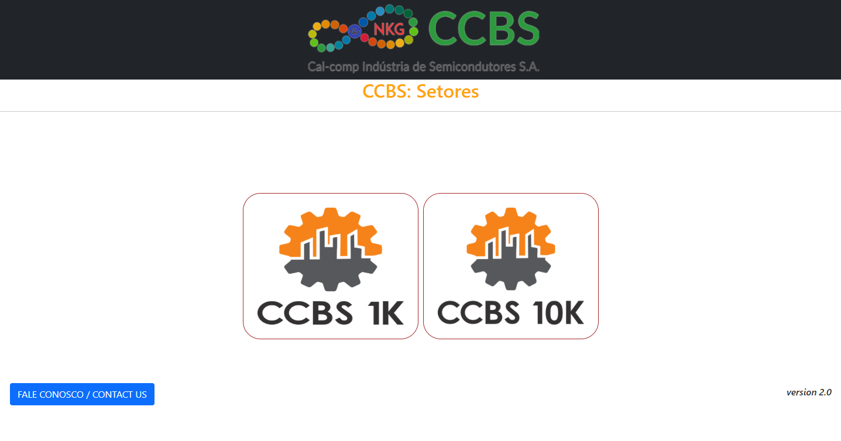
10k sector button
1k sector button

Slide 3
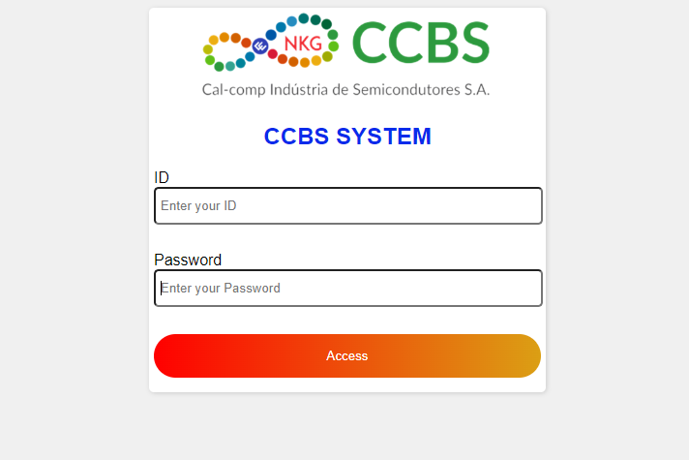
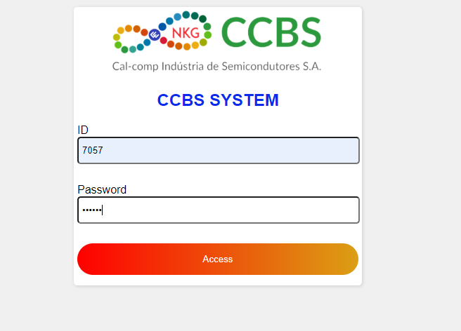
ID will be the employee
registration number
Example
The password will be provided by the developers
Access button

Slide 4


Slide 5
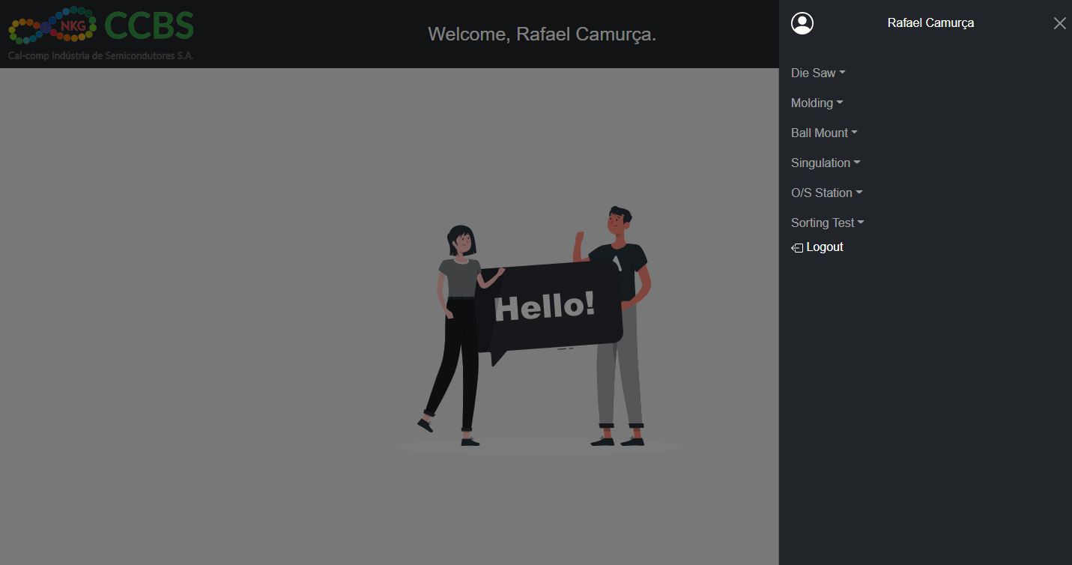
1
Logged in employee name
2
3
4
5
6
1 – Die Saw: Blade Lifetime Control. Under development
2 – Molding: Compound calculation per production. Done
3 – Ball Mount: Solder Paster calculation per production. Under development
4 – Singulation: Blade Lifetime Control. Done
5 – O/S Station: Pogo pin Lifetime control. Done
6 – Sorting Test: Daily Report for production ADTB or PHISON . Under development

Slide 6
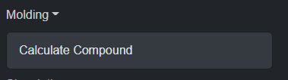
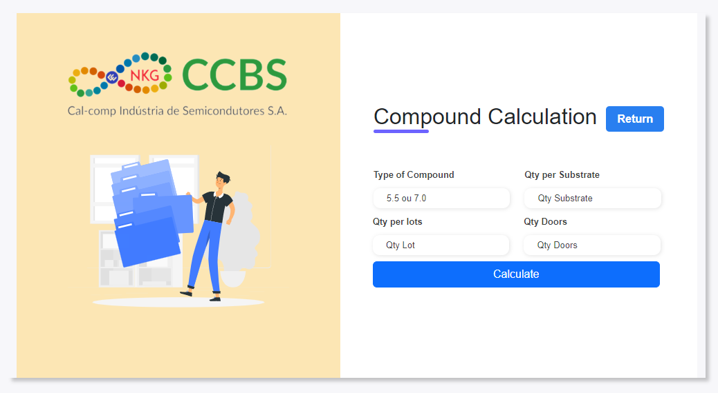
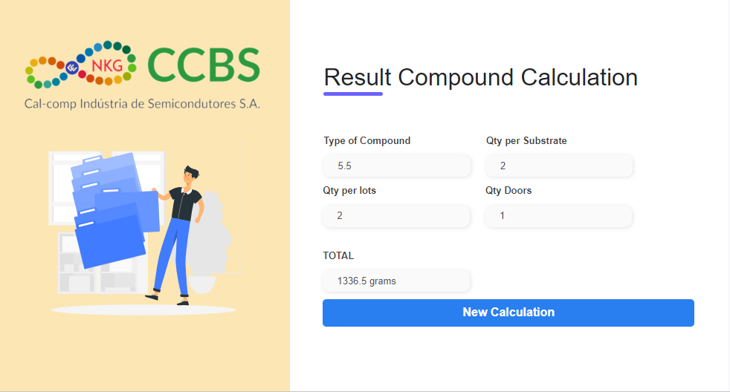
Compound Calculator: It will perform the calculation in grams of the compound to be produced daily, with items per batch and (or) substrate.
With security features like:
mandatory fields and rejection of negative numbers.
Result compound calculation: Printed screen with the information calculated with the generated final result.

Slide 7
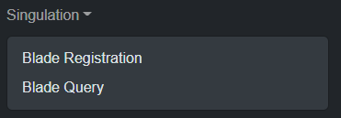
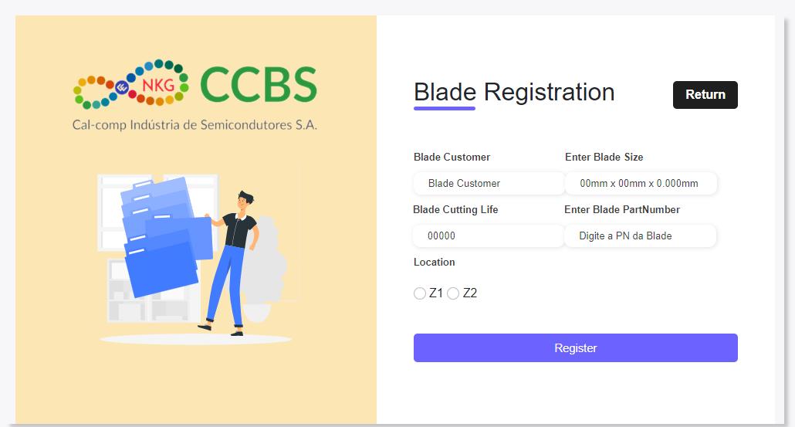
Blade registration screen: Fields such as Blade Customer, Enter Blade Size, Blade Cut Life, Enter Blade Part Number and Location (Z1 or Z2)
Register: registration button.
Return: return to menu.

Slide 8
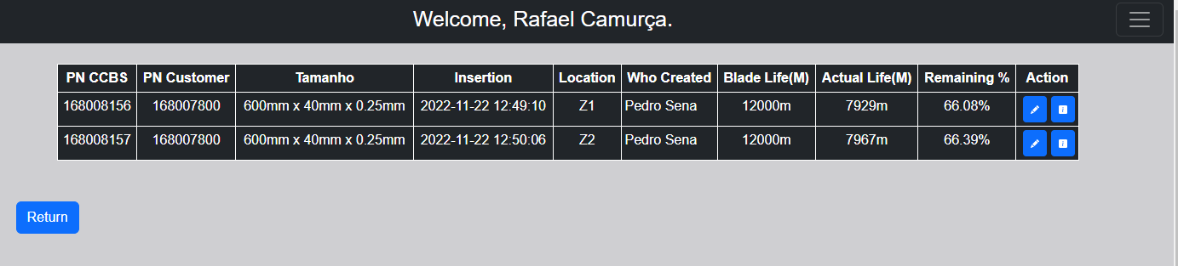
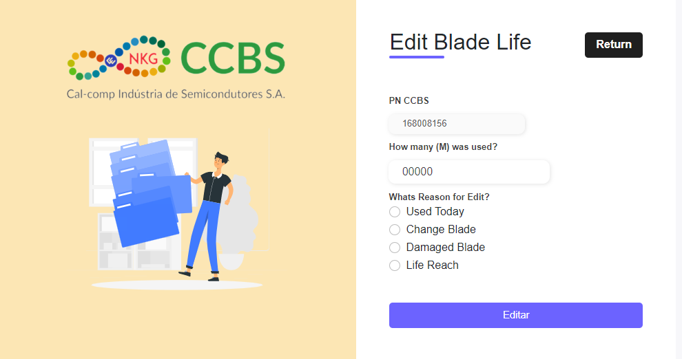
Edit details button
Edit button
Blade useful life editing screen: It will provide the registered data from the registration screen, informing the employee who performed the editing, date, time and reason for which it was edited.
The system has security against undue entries and editions such as: Mandatory fields to be filled in, rejection of negative numbers, editing button will be disabled at the end of the useful life or damage of the blade.

Slide 9
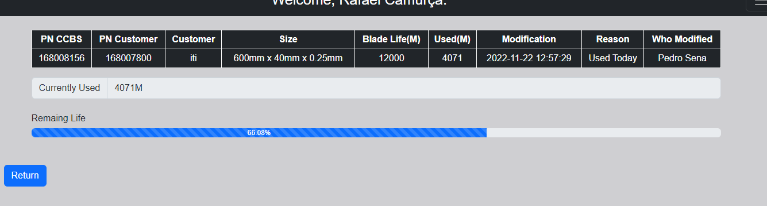
Editing details screen, where the general editing details of the useful life of the blade will be displayed, containing: Currently Used, Remaing Life in dynamic bar

Slide 10
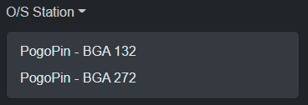
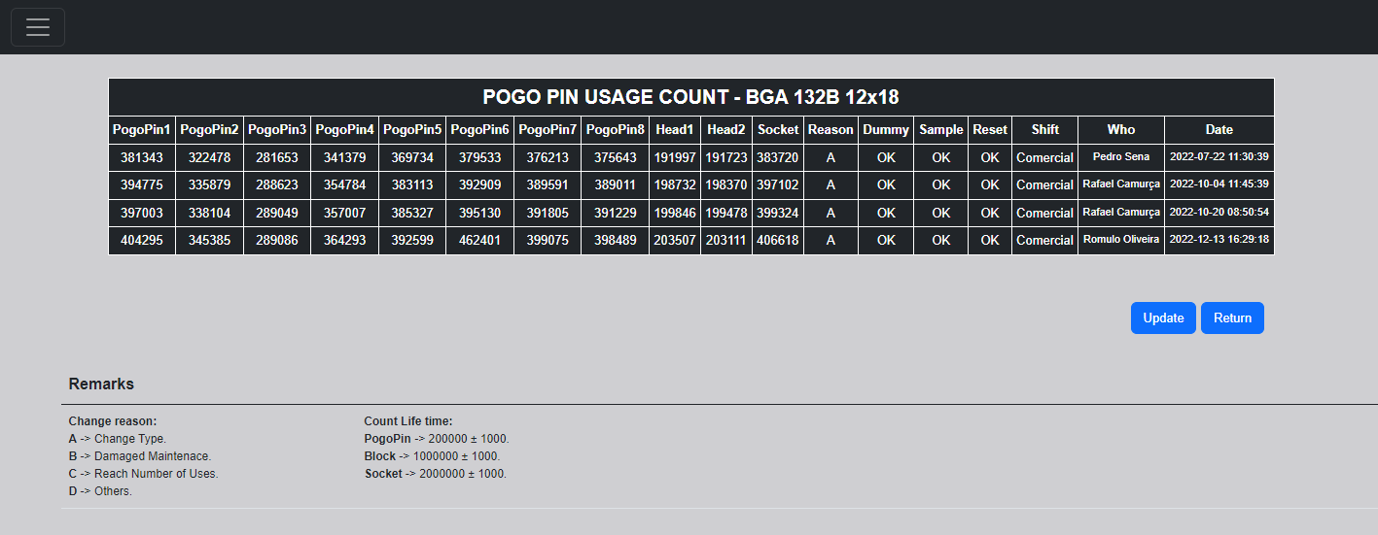
Update Button
Return Menu Button
This screen is for POGOPIN132, there is a similar one for POGOPIN272.
The first screen will show the history of changes made to the POGOPIN and will bring us two buttons, one to return to the menu and the other to update, when the BOST001 machine KIT is changed again and the POGOPIN information needs to be updated.
There are still some notes at the bottom of the screen.

Slide 11
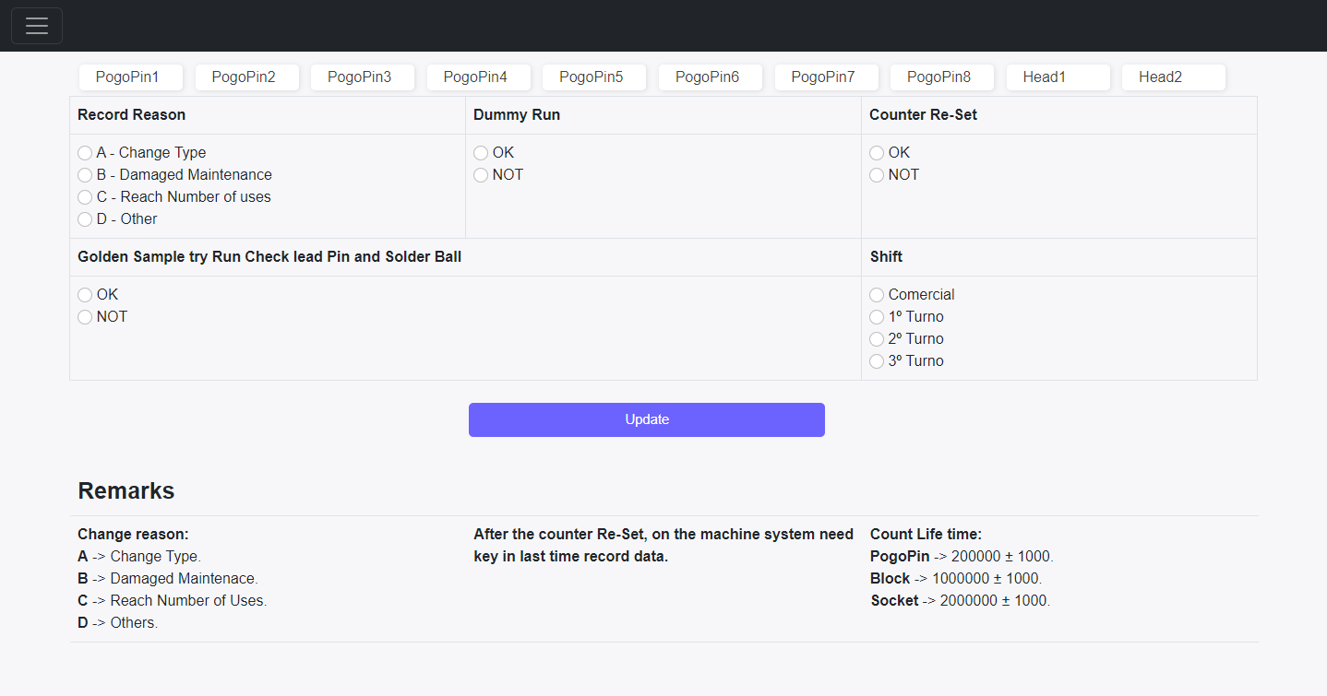
Clicking on the update button, you will come to this screen, in which the information corresponding to the kit exchange will be entered and selected. After entering the information and clicking on the update button, the information will be saved in the database and you will be redirected to the initial screen of the history and you will be able to see the update.

Slide 12


Slide 13
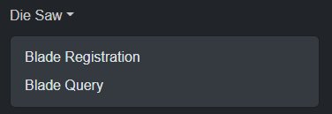
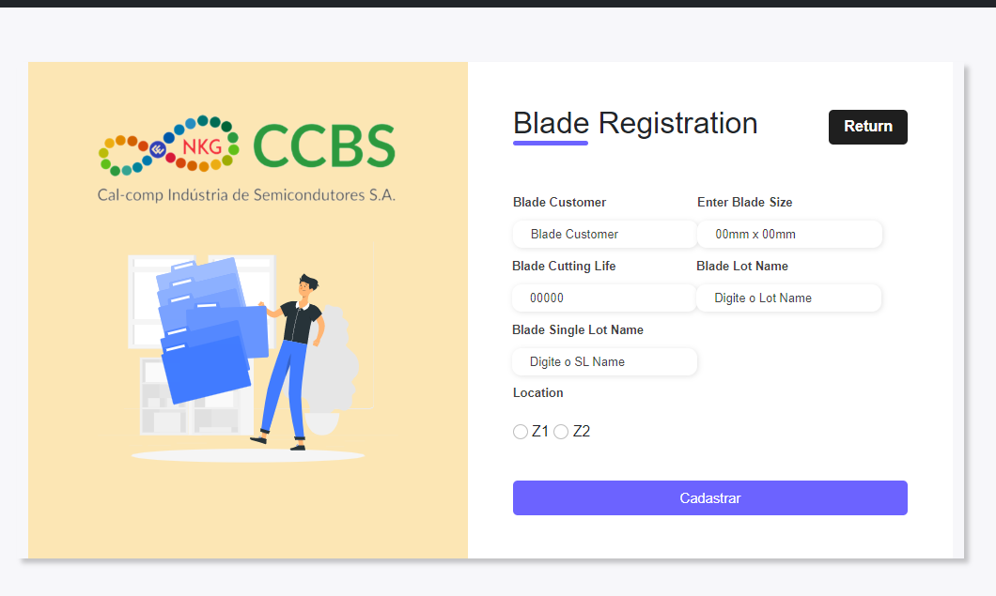
Under development
The useful life system of the Die Saw will be similar to that of the Singulation, however the Blade Single Lot Name field will be added and the Blade Cutting Life field will have a modification in the calculation according to the information provided by the person in charge of the machine.
Blade registration screen: Fields such as Blade Customer, Enter Blade Size, Blade Cutting Life, Blade Lot Name, Blade Single Lot Name and Location (Z1 or Z2)
Register: registration button.
Return: return to menu.

Slide 14
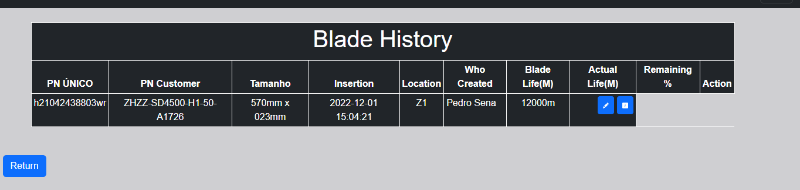
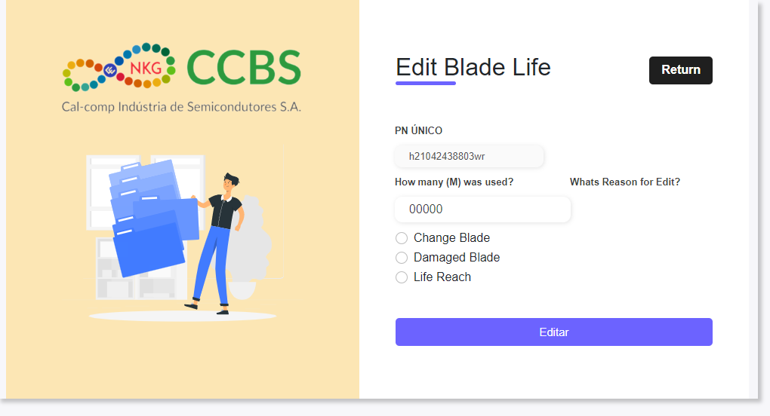
Under development
Blade useful life editing screen: It will provide the registered data from the registration screen, informing the employee who performed the editing, date, time and reason for which it was edited.
The system has security against undue entries and editions such as: Mandatory fields to be filled in, rejection of negative numbers, editing button will be disabled at the end of the useful life or damage of the blade.

Slide 15
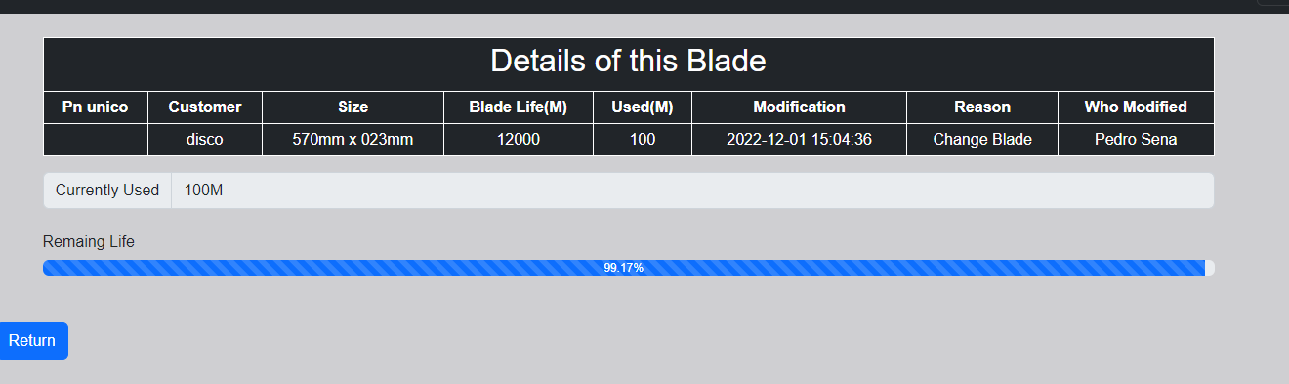
Under development
Editing details screen, where the general editing details of the useful life of the blade will be displayed, containing: Currently Used, Remaing Life in dynamic bar

Slide 16


Slide 17


